Slide 1
Section 194Q: TDS on Purchase of Goods
This document demonstrates the process flow to apply the above rule in Ginesys
Notes:
This is the title page. When possible, add a small description in the section right below for the presentation.

Slide 2
An Introduction
Highlights -
The government has introduced a new Section 194Q under Income Tax, which will be effective from 01-July-2021.
“Any person, being a buyer who is responsible for paying any sum to the seller, for purchase of any goods of the value or aggregate of such value exceeding fifty lakh rupees in an accounting year, shall, at the time of credit of such sum to the account of the seller or at the time of payment thereof by any mode, whichever is earlier, has to deduct an amount equal to 0.1 per cent, as income tax.”
Under Section: 194Q
Effective From: 01-July-2021.
Applied on: Purchase of Goods
Applicable Value: 50L and above in a FY.
Charged @ 0.1%
Notes:
Use this page for every new section in the slides. Add a description below for the section
Add section contents when possible. When not needed, just don’t edit the section and it will not be visible in the slideshow

Slide 3
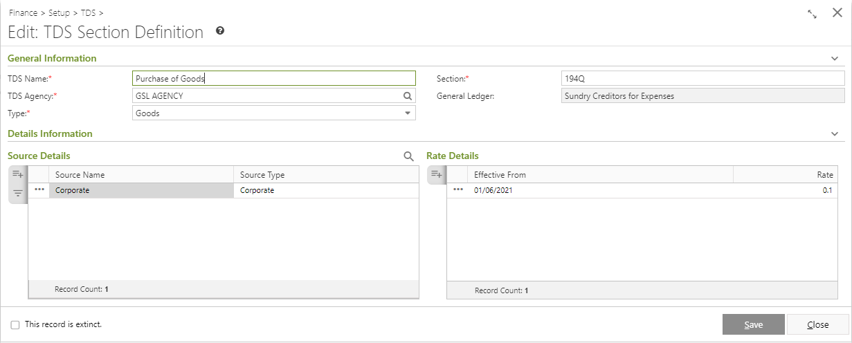
Change in TDS Section
Module Effected:
Finance > Setup > TDS > TDS Section.
Changes:
A new Type field has been added to differentiate TDS Names among Goods and Service type.
All the existing TDS Names will be reflected as Service type.
Note:
Post update, master creation for section 194Q has to be done manually with tagging of all eligible TDS source and their respective TDS rate.
TDS Type in TDS Section

Slide 4
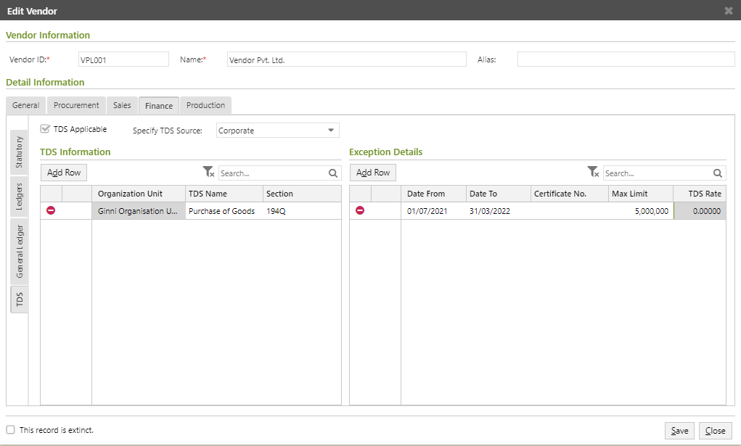
Reflection of TDS Type
Modules Effected:
Procurement > Setup > Vendors > Vendor
S&D > Setup > Customers > Customer
Finance > Setup > Chart of Accounts > Sub Ledger > Others
Finance > Setup > Chart of Accounts > Sub Ledger > Employees
Changes:
Under TDS Information block, a new column has been added for TDS Type.
TDS Name selection can be correctly done by the new TDS Type column in the drop-down list.
Note: Post update, mark the eligible vendors for TDS Applicable and specify the Exception Limit for the year.
TDS Exception definition for Zero rate below 50 lakhs

Slide 5
Derivation of TDS Rate
Vendor Appl. Amount to check Excep. Limit
Vendor Master
Exception Rate
TDS Section
General Rate
TDS AppAmt for PI + TDS Journal - TDS Reversal
+
TDS AppAmt for the Invoice
TDS Rate gets derived based on the Vendor Amount.
Vendor Appl. Amount = Sum of TDS Applicable amount from Purchase Invoice, TDS Journal and TDS Reversal entries
Fetching logic of TDS Rate:
If Vendor Appl. Amount + TDS Applicable Amount of Invoice <= Maximum Limit specified in Vendor master, then TDS Rate gets fetched from the Vendor master.
Else, gets populated from the TDS Section definition.
Exception Limit: <= 50 Lacs
TDS Rate: 0 %
Value > 50 Lacs
TDS Rate: 0.1%

Slide 6
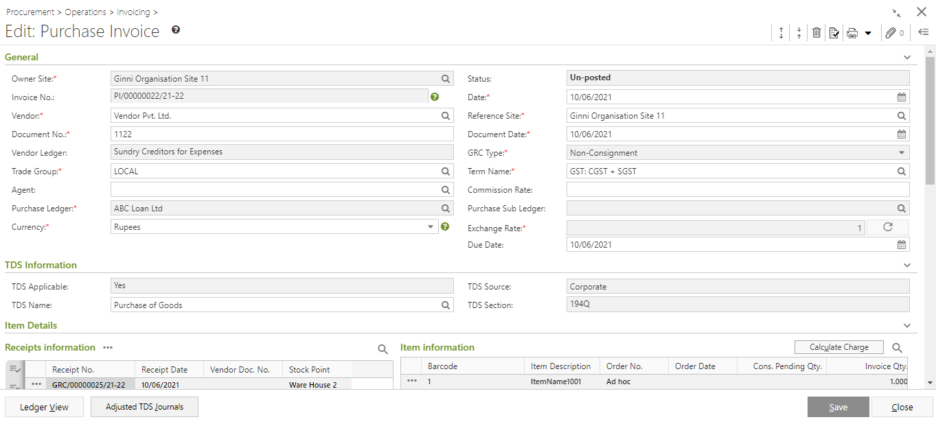
Change in Invoice
Module Effected:
Procurement > Operations > Invoicing > Purchase Invoice
Changes:
A block named ‘TDS Information’ is added below General block
TDS Information block displays
‘TDS Applicable'
‘TDS Source’
‘TDS Name’
'TDS Section’
TDS Section block in Purchase Invoice

Slide 7
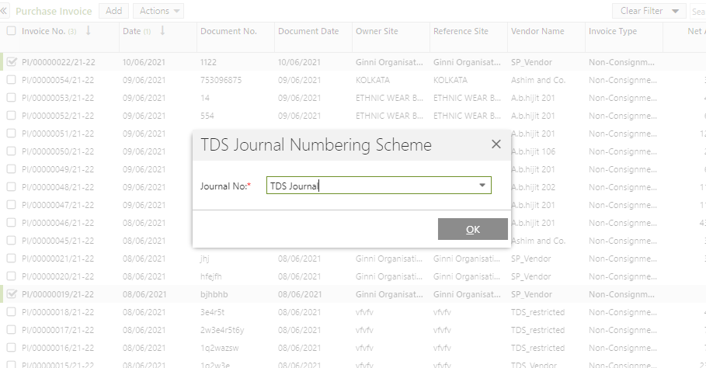
Auto creation of TDS Journal
If Purchase Invoice is TDS Applicable then on Release of any document -
If pending TDS entry is not found then creates TDS Journal entry.
The TDS Journal gets auto-adjusted with the Invoice Amount.
TDS Journal numbering scheme selection on Release of Purchase Invoice
Notes:
Alternate style to break monotony. Use sparingly

Slide 8
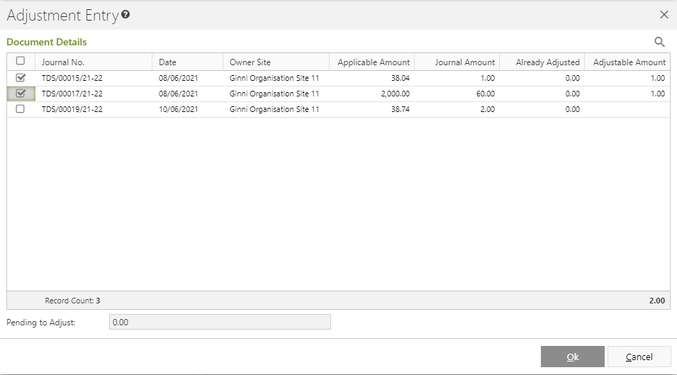
Adjustment of pending Journals
From Advance payments, TDS Journal might be created and are pending to be get adjusted with Invoices.
Purchase Invoice if TDS Applicable then on Release from either list page or edit mode -
Existing TDS Journal entry if found pending, then adjustment of those documents is required
Window pops up to adjust the TDS Journals with the Invoice Amount.
TDS Journal Adjustment window during Release of Purchase Invoice
Notes:
Alternate style to break monotony. Use sparingly

Slide 9
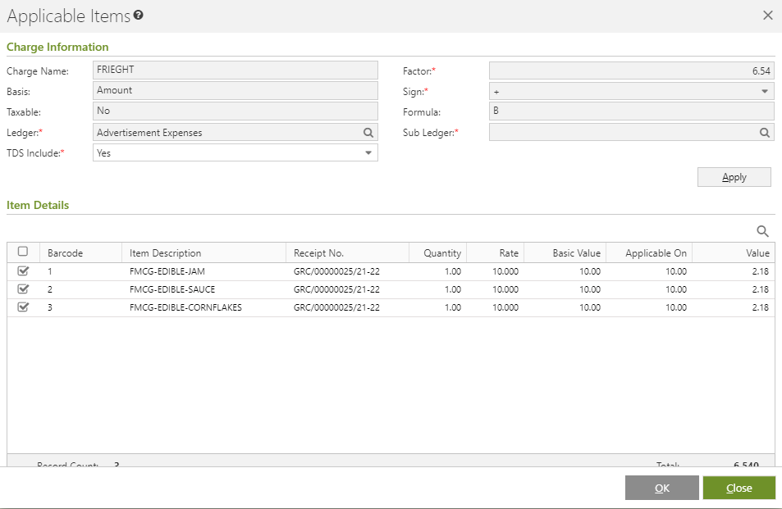
Changes in Item Charge
Charges may or may not be considered in applicable amount to calculate TDS
Module Effected:
Procurement > Operations > Invoicing > Purchase Invoice
Changes:
New field named ‘TDS Include’, has been added in item level charge window opened from the Charge Summary block with option to mark Yes / No.
If selected as Yes, will add the charge amount with item gross to calculate TDS, otherwise not.
Charge View of Purchase Invoice

Slide 10
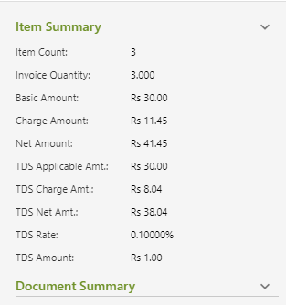
Reflection in Panel
Module Effected:
Procurement > Operations > Invoicing > Purchase Invoice
Changes:
Information w.r.t. TDS has been added under Item Summary block in Panel Information:
'TDS Applicable Amt'
'TDS Charge Amt’
'TDS Net Amt’
'TDS Rate’
'TDS Amount'
Panel Information of Purchase Invoice

Slide 11
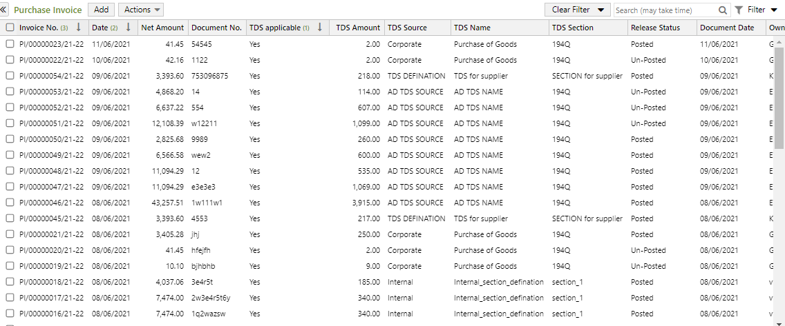
Reflection in List View
Module Effected:
Procurement > Operations > Invoicing > Purchase Invoice
Changes:
New columns have been added to the list view w.r.t. TDS as below-
'TDS Applicable'
'TDS Amount'
'TDS Source'
'TDS Name'
'TDS Section'
List View of Purchase Invoice

Slide 12
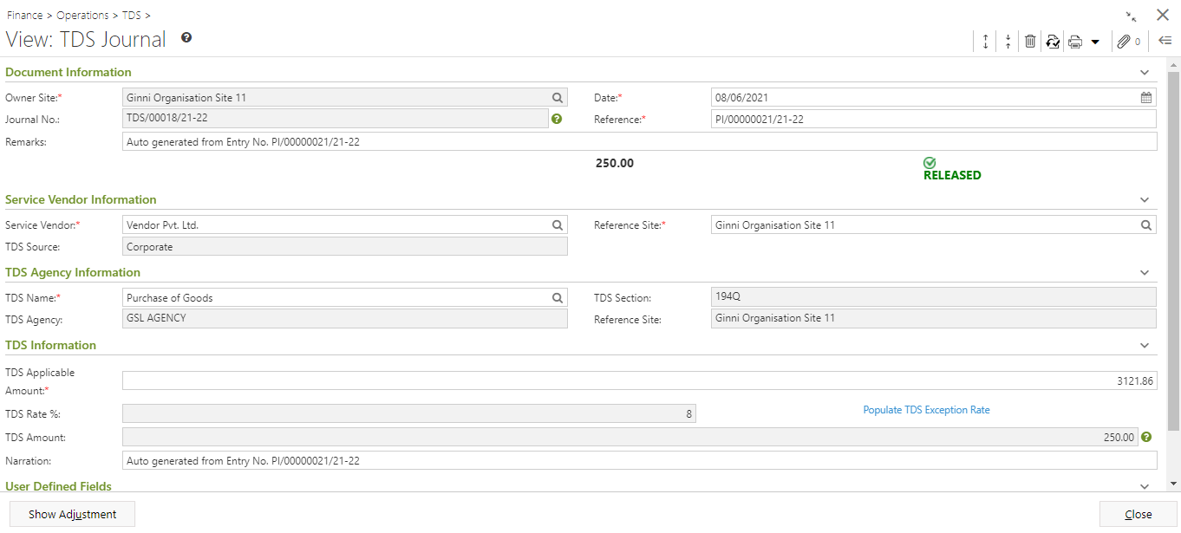
Understanding the auto TDS Journal
Reference No., Remarks and Narration fields reflect the source entry i.e Purchase Invoice number
TDS Journal entry view

Slide 13
To summarize, steps to follow:
Create TDS Section with type as ‘Goods’.
Define Rate for each applicable sources @ 0.1%.
In Vendor master, mark TDS Applicable with source selected.
Specify exception of 50 Lacs in Vendor master.
1
2
3
4
While creation of Purchase Invoice, select TDS Name.
On Release of PI, select TDS Journal document numbering scheme.
5
6

Slide 14
Assumptions
Organization Turnover limit for 10 Cr. has to be self validated, i.e. if not applicable, then TDS configuration should not be done. If configured then will always be charged.
Exception Limit is not validated on advance payment from AP Voucher. Manual option available for population of Exception limit, irrespective of limit check.
Un-registered vendor needs to be handled by self definition. Suggested to create separate TDS Source with applicable TDS rate applied.
Purchase Invoice in which exception limit is crossed with partial value, TDS will be charged on full amount i.e. adjustment of differential value is not done.
Purchase Invoice made against advance payment, both advance and current bill will be counted for exception limit, coz, adjustment of advance is done after saving of invoice.
Both Inventory and Non-Inventory items are considered under this taxation, as no separation mentioned in rule.
TDS Journal or Reversal created against Purchase Return / Debit Note / Credit Note are not automatically adjusted. These needs to be manually done.
From Seller side view, if TDS is deducted by buyer, then the seller needs to account for advance tax paid. This entry he needs to do while preparing AR and will remain a manual Credit Journal document.

Slide 15
Thank you

